Slide 1



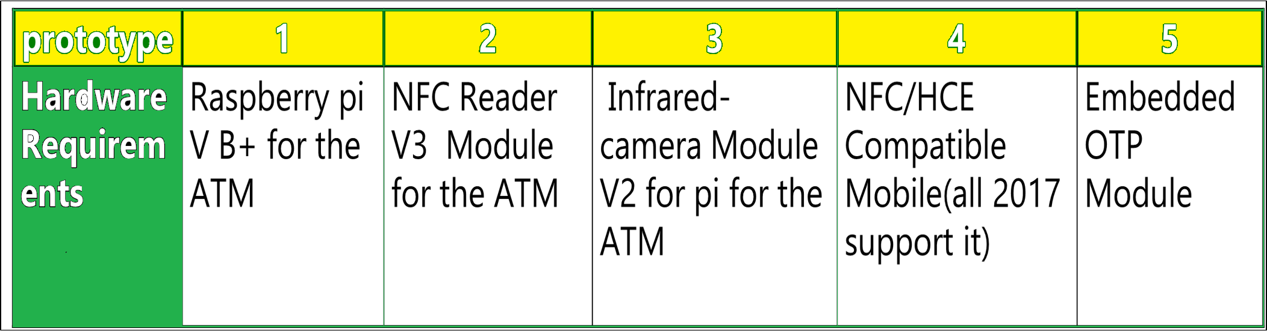
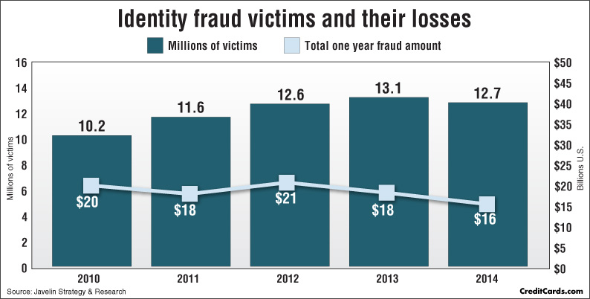
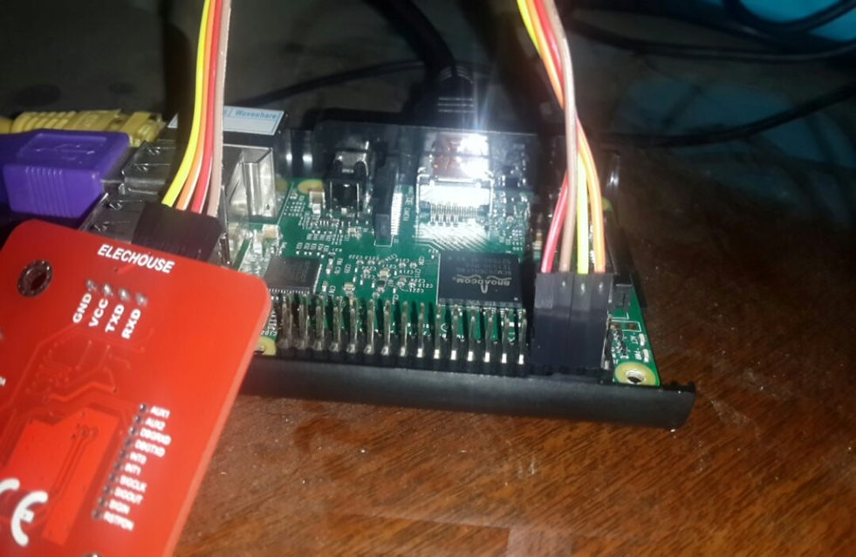
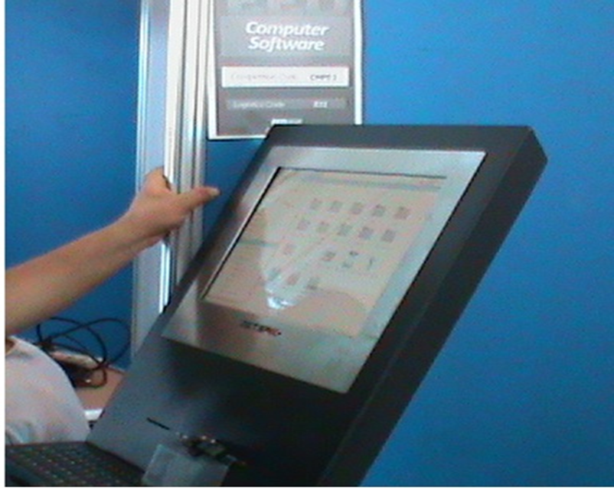
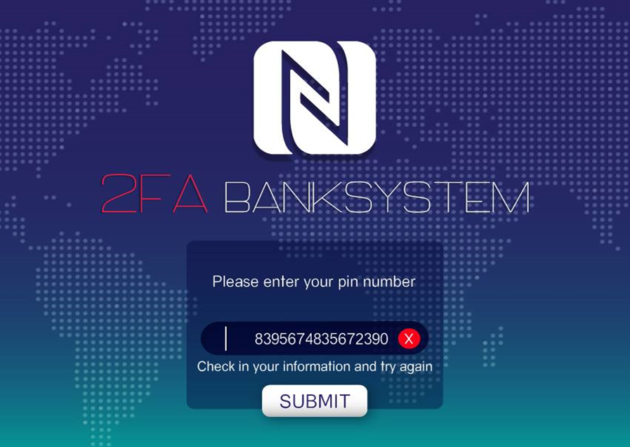
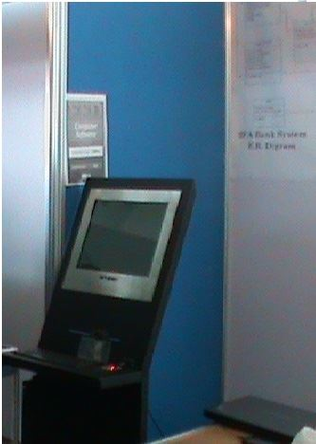
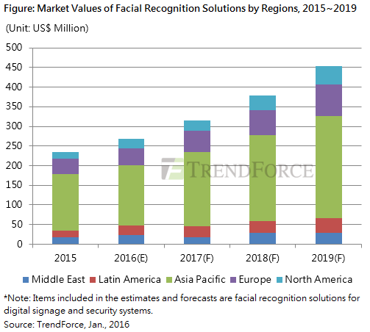
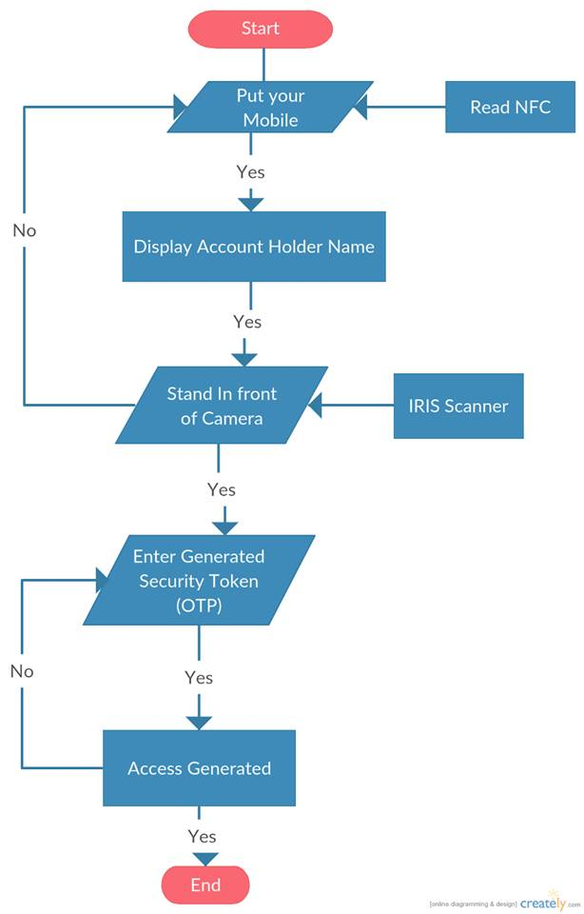
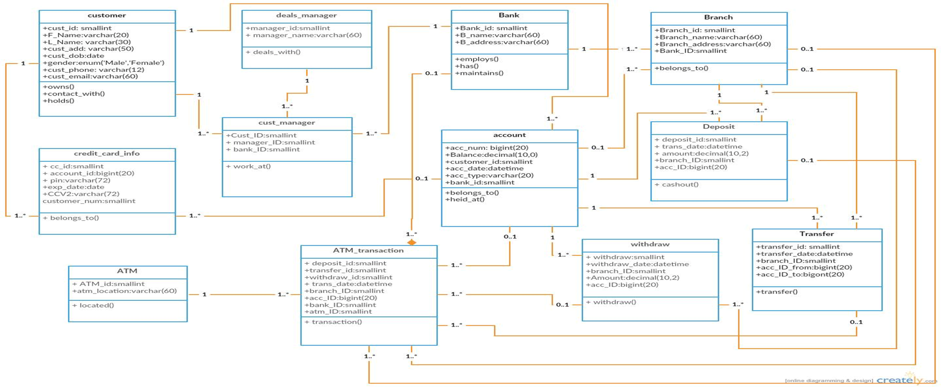
2FA Banking System
Modern Academy for Engineering & Technology
Abstract
Hardware Used
Problem Statics
The advancement in new technologies has significantly resulted more perfection in authentication issues. In ATM machine, access permission is usually taking personal identification numbers (PIN) for authentication. Through our project, this old method is being exhausted by introducing a combination of embedded and bio-metric molding to setup an ATM simulator. iris recognition followed by the onetime password (OTP) will help the user for smart and secured transactions. It will reduced the bank fraud and makes the banking systems more secured compare to current version.The customer is identified by using a mobile wallet app with NFC Technology using HCE and an One-Time Password (OTP) mechanism mixed with biometric authenticator for Iris verification.
Objectives
No more credit/debit card
Minimize Banking Frauds
Applicability and Cost Reducing
Satisfies Market Needs
Availability and ease of use
Online banking and Mobile payments Easier and Safer
Introduction
Technologies Used
MYSQL 5.6
PHP 5
HTML 5
opencv3.1.0
python 2.7
PyQT Designer
Centos 7
Encryption Algorithms HMACSHA512
OpenSSL/TLS
snort IPS
HCE Android API
NFC API
The multifactor authentication is an approach to authentication which requires the presentation of two or more authentication factors: a knowledge factor ("something only the user knows"), a possession factor ("something only the user has"), and an inherence factor ("something only the user is").
Automation has made a positive impact overall, but various financial institutions like banks and applications like ATM are still subjected to thefts and frauds. The existing ATM model uses a card and a PIN which gives rise to increase in attacks in the form of stolen cards and identity fraud, or due to statically assigned PINs, duplicity of cards and various other threats. To overcome, hybrid model which consists of conventional features along with additional features like Iris recognition, NFC technology and one-time password (OTP) is used
Iris recognition is a form of biometric identification performed with computer vision. The iris is an internal organ whose texture is randomly determined during embryonic gestation. It is at and its texture is relatively stable, as the iris is protected from external harm. All these features make it a very viable form of biometric recognition.
The user usually starts with putting his mobile on the NFC reader but must also have the OTP Device and its PIN correctly remembered for pre verification before the Iris scanning starts for Last verification before grant account access.
Conclusion
This project is developed on the basis of more need of security in ATM banking system. Now-a-day’s ATM is getting less secure with emerging ways to hack/crack ATM PIN or ATM card. Use of OTP and Biometric is best and easy way to deal with these security threats. This project is using SHA-2 algorithm to generate OTP with more randomness provided in proposed system after generation of SHA-2 hash string. The ATM will be safer than having only one way of accessing transactions; that is to say having OTP Device accesses and Iris recognition login credentials creates more security as one has to pass both security barriers before having access to the transactions. Also we are using the Raspberry Pi V2 and IR camera to take the cost to its minimum. Another important point in proposed system is that it demands lesser changes to the present system of Bank and ATM. That means lesser overhead will be required to change the whole system with enhanced security. Changes in Hardware part will be required that is one NFC Reader is required to be attached to ATM machines. This project will needs to explained to end user, to educate the user to use this system. In future work this project can use enhanced and more accurate equipment with better algorithms.
Solution Diagrams
Overview
The ATM system consists of IR camera embedded in machine based on raspberry pi v2 that will recognize the Iris standing about 0.25m in front of system and perform matches against the Supposed he/she dataset.
The user usually starts with putting his mobile on the NFC reader but must also have the OTP Device and its PIN correctly remembered for pre verification before the Iris scanning starts for Last verification before grant account access.
Same Authentication Steps is used for Online-Banking and Mobile Banking from normal Desktop or Laptop with webcam (for NFC reader will be supported in almost every laptop vendor from 2017 ”Desktop users needs NFC Reader”) or any Smart Phone 2016 or later.
Mobile Payments is easier and safer than ever been
References
. Rupinder Saini, Narinder Rana,Rayat 'Comparison of various biometric methods', Institute of Engineering and IT, International Journal of
Advances in Science and Technology (IJAST) Vol 2 Issue I (March 2014)
2. Devinaga, R. (2010). ATM risk management and controls. European journal of economic, finance and administrative sciences. ISSN 1450-
2275 issue 21.
3. A.Forouzan, Cryptography and Network Security, Tata McGraw Hill
4. Anil K. Jain and Arun Ross. Introduction to Biometrics. In Anil K. Jain, Patrick Flynn, and Arun. A. Ross, editors, Handbook of Biometrics.
Springer US, 2008.
5. Rafael C. Gonzalez and Richard E.Woods, Addison Wesley, Digital Image Processing.
6. Ekenel HK, Stallkamp J, Gao H, Fischer M, Stiefelhagen R, Face Recognition For Smart Interacations, interact Research, Computer Science
Department, University at Karlsruhe.
7. Sezin Kaymak , “Enhanced Principal Component Analysis Recognition Performance”.
8. Vinay Hiremath and Ashwini Mayakar, Face recognition using Eigenface approach.
9. Aru, Okereke Eze, Ihekweaba Gozie, Facial Verification Technology for Use In Atm Transactions
10. IOSR Journal of Computer Engineering (IOSR-JCE) e-ISSN: 2278-0661, p- ISSN: 2278-8727Volume 15, Issue 1 (Sep. - Oct. 2013),PP 22-29
11. http://www.ics.uci.edu/~smyth/courses/ics178/random_number_generators article.pdf

